Slide 1
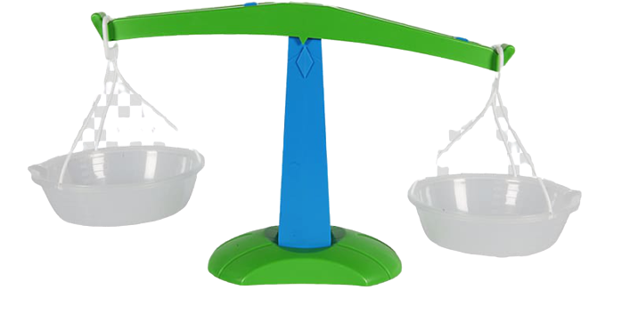
WELCOME TO MATH, SCIENCE, and SOCIAL STUDIES- Miss Scalzo/Mr. McCaffrey’s Fourth Grade
About Ms. Scalzo...
Contact Ms. Scalzo !
Daily Schedule
Reminder passwords/user
Social Studies
MATH
SCIENCE

Slide 2
Hi there!
I am Ms. Scalzo!
I have been teaching at Wappingers for 14 years!
5 things you should know about me:
I have a twin sister! She teaches at Fishkill Elementary and NO we do not look alike!
I have a couple of dogs, Pippa and Finster. Pippa is perfect, Finster is “working on it”. Pippa is a black lab mix and Finster is an Australian Cattle Dog. They both love whipped cream from the can.
I love: dogs, drawing, laughing, Disney movies (and singing their songs randomly), my friends, my family, french fries, PIZZA, walking beaches and amusement parks at night, Bob’s Burgers, including others, smiling at people who need it.
I do NOT love: people who don’t take time to understand others, mean people, certain words that some people don’t think are mean, rudeness, not being responsible
BACK

Slide 3
My contact information:
Email: Nicole.Scalzo@wcsdny.org
I am available from 8:25-3:25 daily.
I will do my best to check and respond to all my emails each morning and throughout the school day.
In the rare event that they are not replied to by the day you sent them, they will be the next day.
If several days have passed- please just send me a gentle email reminder- thank you in advance! BACK

Slide 4
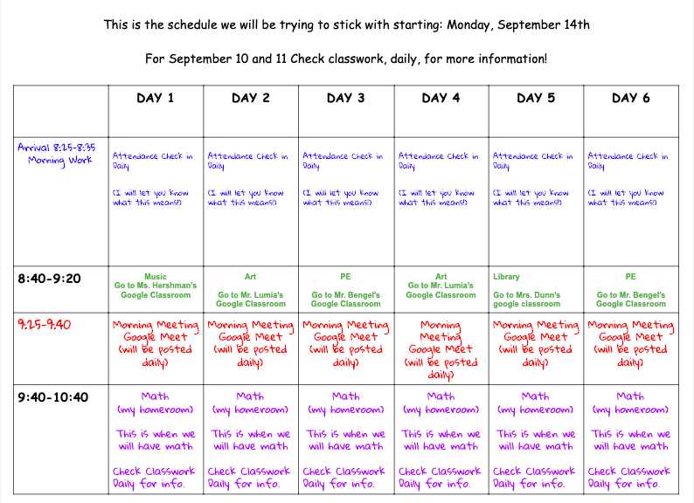
SCHEDULE (subject to change)
FIRST HALF OF THE DAY
Next...

Slide 5
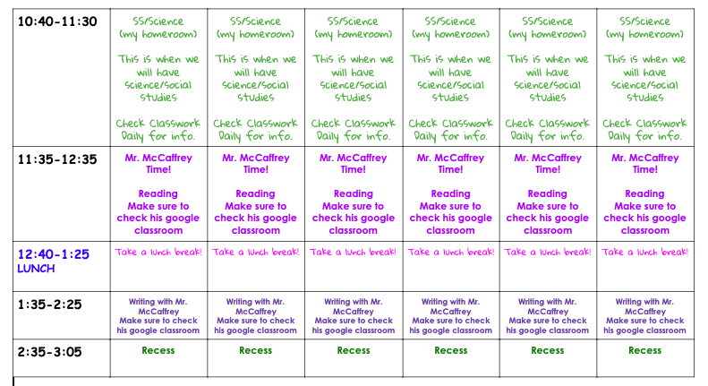
BACK

Slide 6
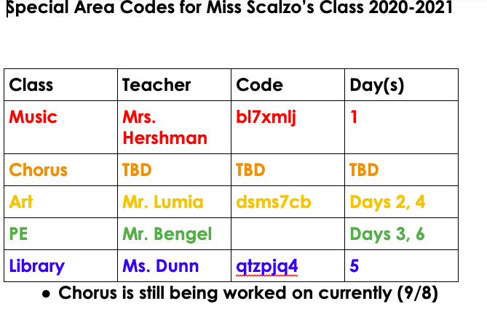
BACK

Slide 7
Username and Password Info

Slide 8
MATH
What should I already know in math? And what will we be learning?
What websites can we use for math?
What materials should I have for math?
BACK

Slide 9
What should I already know in math, so that I can have a successful year?
What will we be learning this year?
Adding and subtracting up to four digits with and without regrouping
Place value
Ways to write numbers
Factors and multiples
Division up to four digits with and without remainders
Fractions
Geometric shapes and characteristics
Multiplication facts!!!!
Division facts
adding/subtracting facts
Basic operations
Basic concepts/ideas about fractions
Solving one step word problems (2 even better!)
Basic area/perimeter
Basic geometry terms
BACK

Slide 10
What websites can we use for math?
All the websites available to us will be on clever (clever.com)!
Also, check out some of the games that I’ve listed on our webpage under math! (some may not be working anymore)
BACK

Slide 11
Materials for Math:
I’d love for you to have a dry erase board, markers, and something to erase it with.
During math, it’s also good to have scrap paper to work on.
There may be times I ask you to print something ahead of time, please make sure to do this if possible!
BACK

Slide 12
SCIENCE
What will we be learning this year?
Animal adaptations for survival
Sound Waves
Light reflection
Energy and Speed
Claims, Evidence, and Elaboration
BACK

Slide 13
SOCIAL STUDIES
What will we be learning this year?
Cause and effect
Claim, Evidence, Elaboration
Natives of NYS
European Explorers of NYS
The American Revolution
Women’s Rights and Equality
BACK

